Slide 1
Data Mining Concepts and Techniques Module 2 Data Preprocessing
‹#›

Slide 2
Data Preprocessing
Why preprocess the data?
Data cleaning
Data integration and transformation
Data reduction
Discretization and concept hierarchy generation
‹#›

Slide 3
Why Data Preprocessing?
Data in the real world is dirty
incomplete: lacking attribute values, lacking certain attributes of interest, or containing only aggregate data
e.g., occupation=“ ”
Inaccurate or noisy: containing errors, or values that deviate from the expected(outliers)
e.g., Salary=“-10”
inconsistent: containing discrepancies in department codes or names used to categorize the items
e.g., Age =”5 years”, Birthday =”06/06/1990″, Current Year =”2017″
e.g., Was rating “1,2,3”, now rating “A, B, C”
e.g., discrepancy between duplicate records
‹#›

Slide 4
Why Is Data Dirty?
Incomplete data may come from
“Not applicable” when data value collected
Different considerations between the time when the data was collected and when it is analyzed.
Human/hardware/software problems
Noisy data (incorrect values) may come from
Faulty data collection instruments
Human or computer error at data entry
Errors in data transmission
Inconsistent data may come from
Different data sources
Functional dependency violation (e.g., modify some linked data)
Duplicate records also need data cleaning
‹#›

Slide 5
Why Is Data Preprocessing Important?
No quality data, no quality mining results!
Quality decisions must be based on quality data
e.g., duplicate or missing data may cause incorrect or even misleading statistics.
Data warehouse needs consistent integration of quality data
Data extraction, cleaning, and transformation comprises the majority of the work of building a data warehouse
‹#›

Slide 6
Multi-Dimensional Measure of Data Quality
A well-accepted multidimensional view:
Accuracy: degree to which information reflects an object
Completeness: when it fulfils expectations of comprehensives
Consistency: information stored at different places matches.
Timeliness: If information is available when we need it
Believability: How much data are trusted by users
Interpretability: How easily data are understood
‹#›
Notes:
‹#›

Slide 7
Major Tasks in Data Preprocessing
Data cleaning
Fill in missing values, smooth out the noisy data, identify or remove outliers, and resolve inconsistencies
Data integration
Integration of multiple databases, data cubes, or files
Data transformation
Normalization and aggregation
Data reduction
Obtains reduced representation in volume but produces the same or similar analytical results
Data discretization
Part of data reduction but with particular importance, especially for numerical data
‹#›

Slide 8
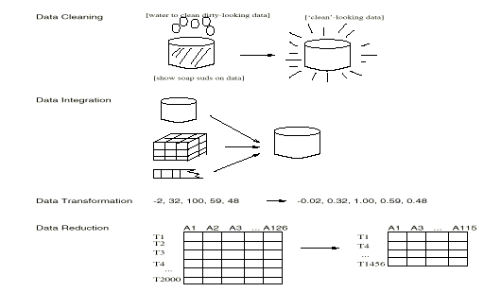
Forms of Data Preprocessing
‹#›

Slide 9
Data Preprocessing
Why preprocess the data?
Data cleaning
Data integration and transformation
Data reduction
Discretization and concept hierarchy generation
Summary
‹#›

Slide 10
Data Cleaning
Data cleaning tasks
Fill in missing values
Identify outliers and smooth out noisy data
Correct inconsistent data
Resolve redundancy caused by data integration
‹#›

Slide 11
Data Cleaning:Missing Data
Data is not always available
E.g., many tuples have no recorded value for several attributes, such as customer income in sales data
Missing data may be due to
equipment malfunction
inconsistent with other recorded data and thus deleted
data not entered due to misunderstanding
certain data may not be considered important at the time of entry
Missing data may need to be inferred.
‹#›

Slide 12
How to Handle Missing Data?
Ignore the tuple: usually done when class label is missing assuming the tasks in classification—not effective when the percentage of missing values per attribute varies considerably.
Fill in the missing value manually: tedious + infeasible?
Use a global constant to fill in the missing value: Replace all missing attribute values by the same constant such as a label like “Unknown”
Use a measure of central tendency for the attribute (e.g., the mean or median) to fill in the missing value.
Use the attribute mean or median for all samples belonging to the same class as the given tuple.
Use The most probable value: inference-based such as Bayesian formula or decision tree
‹#›

Slide 13
Data Cleaning:Noisy Data
Noise: random error or variance in a measured variable
Meaningless data that can not be interpreted by machines
Noisy data (incorrect values) may come from
Faulty data collection instruments
Human or computer error at data entry
Errors in data transmission
‹#›

Slide 14
How to Handle Noisy Data?
I. Binning
Binning is a technique where we sort the data and then partition the data into equal frequency bins. Then you may either replace the noisy data with the bin mean bin median or the bin boundary.
There are three methods for smoothing data in the bin.
Smoothing by bin mean method: In this method, the values in the bin are replaced by the mean value of the bin.
Smoothing by bin median: In this method, the values in the bin are replaced by the median value.
Smoothing by bin boundary: In this method, the minimum and maximum values of the bin values are taken, and the closest boundary value replaces the values.
‹#›

Slide 15
How to Handle Noisy Data?
I. Binning Example
Sorted data for price (in dollars): 4, 8, 9, 15, 21, 21, 24, 25, 26, 28, 29, 34
* Partition into equal-frequency (equi-depth) bins:
- Bin 1: 4, 8, 9, 15
- Bin 2: 21, 21, 24, 25
- Bin 3: 26, 28, 29, 34
* Smoothing by bin means:
- Bin 1: 9, 9, 9, 9
- Bin 2: 23, 23, 23, 23
- Bin 3: 29, 29, 29, 29
* Smoothing by bin boundaries:
- Bin 1: 4, 4, 4, 15
- Bin 2: 21, 21, 25, 25
- Bin 3: 26, 26, 26, 34
‹#›

Slide 16
How to Handle Noisy Data?
II. Regression
This is used to smooth the data and will help to handle data when unnecessary data is present.
For the analysis, purpose regression helps to decide the variable which is suitable for our analysis.
Linear regression refers to finding the best line to fit between two variables so that one can be used to predict the other.
Multiple linear regression involves more than two variables.
Using regression to find a mathematical equation to fit into the data helps to smooth out the noise.

Slide 17
How to Handle Noisy Data?
III. Outlier Analysis
detect and remove outliers
‹#›

Slide 18
III. Outlier Analysis
Outliers may be detected by clustering, where similar or close values are organized into the same groups or clusters. Thus, values that fall far apart from the cluster may be considered noise or outliers. Outliers are extreme values that deviate from other observations on data. They may indicate variability in measurement, experimental errors, or novelty. In other words, an outlier is an observation that diverges from an overall pattern on a sample. Outliers can be the following kinds, such as:
Univariate outliers can be found when looking at a distribution of values in a single feature space.
Multivariate outliers can be found in an n-dimensional space (of n-features). Looking at distributions in n-dimensional spaces can be very difficult for the human brain. That is why we need to train a model to do it for us.
Point outliers are single data points that lay far from the rest of the distribution.
Contextual outliers can be noise in data, such as punctuation symbols when realizing text analysis or background noise signal when doing speech recognition.
Collective outliers can be subsets of novelties in data, such as a signal that may indicate the discovery of new phenomena.

Slide 19
Data Preprocessing
Why preprocess the data?
Data cleaning
Data integration and transformation
Data reduction
Discretization and concept hierarchy generation
Summary
‹#›

Slide 20
Data Integration
Data integration:
Combines data from multiple sources into a coherent store to retain and provide a unified perspective of the data.
Data Integration Challenges/Issues:The semantic heterogeneity and structure of data.
Schema integration:
Integrate metadata from different sources.
e.g., A.cust-id ≡ B.cust-#
Analyzing metadata statistics will prevent you from making errors during schema integration.
Entity identification problem:
The problem of identifying object instances from different databases that correspond to the same real-world entity .
e.g., Bill Clinton = William Clinton.
Structural Integration:. Ensure that any attribute functional dependencies and referential constraints in the source system match those in the target system.
Redundancy and Correlation Analysis
Tuple Duplication
‹#›

Slide 21
Data Integration
Data Integration Challenges/Issues:
The semantic heterogeneity and structure of data pose great challenges in data integration.
Schema integration:
Integrate metadata from different sources.
Structural Integration: When matching attributes from one database to another during integration, special attention must be paid to the structure of the data i.e. ensure that any attribute functional dependencies and referential constraints in the source system match those in the target system.
For example, you were given client data from specialized statistics sites. Customer identity is assigned to an entity from one statistics supply, while a customer range is assigned to an entity from another statistics supply. Analyzing such metadata statistics will prevent you from making errors during schema integration.
Redundancy and Correlation Analysis
Tuple Duplication
‹#›

Slide 22
Data Integration
When matching attributes from one database to another during integration, special attention must be paid to the structure of the data i.e. ensure that any attribute functional dependencies and referential constraints in the source system match those in the target system.
For example, assume that the discount is applied to the entire order in one machine, but in every other machine, the discount is applied to each item in the order. This distinction should be noted before the information from those assets is included in the goal system.
‹#›

Slide 23
Handling Redundancy in Data Integration
Redundant data occur often while integrating multiple databases.
Unimportant data that are no longer required are referred to as redundant data.
Object identification: The same attribute or object may have different names in different databases
Derivable data: One attribute may be a “derived” attribute in another table, e.g., annual revenue,age
Inconsistencies in attribute or dimension naming can also cause redundancies in the resulting data set.
Some redundancies can be detected by correlation analysis.
‹#›

Slide 24
Suppose we have a data set that has three attributes - pizza_name, is_veg, is_nonveg
Is_veg is 1; if the selecting pizza is veg else, it is 0.
Is_nonveg is 1; if the selecting pizza is nonveg else, it is 0.
On analyzing the above table, we have found that if a pizza is not veg (i.e., is_veg is 0 selecting the pizza_name), the pizza is surely non-veg (Since there are only two values in the pizza_name output class- Veg and Nonveg). Hence, one of these attributes became redundant. It means that the two attributes are very much related to each other, and one attribute can find the other. So, you can drop either the first or second attribute without any loss of information.
Age and DoB attribute.
Age can be derived from DoB.

Slide 25
Correlation Analysis
Given two attributes , correlation analysis can measure how strongly one attribute implies the other, based on the available data.
For nominal data, we use the x² (chi-square) test.
For numeric attributes, we can use the correlation coefficient and covariance, both of which assess how one attribute values vary from those of another.
‹#›

Slide 26
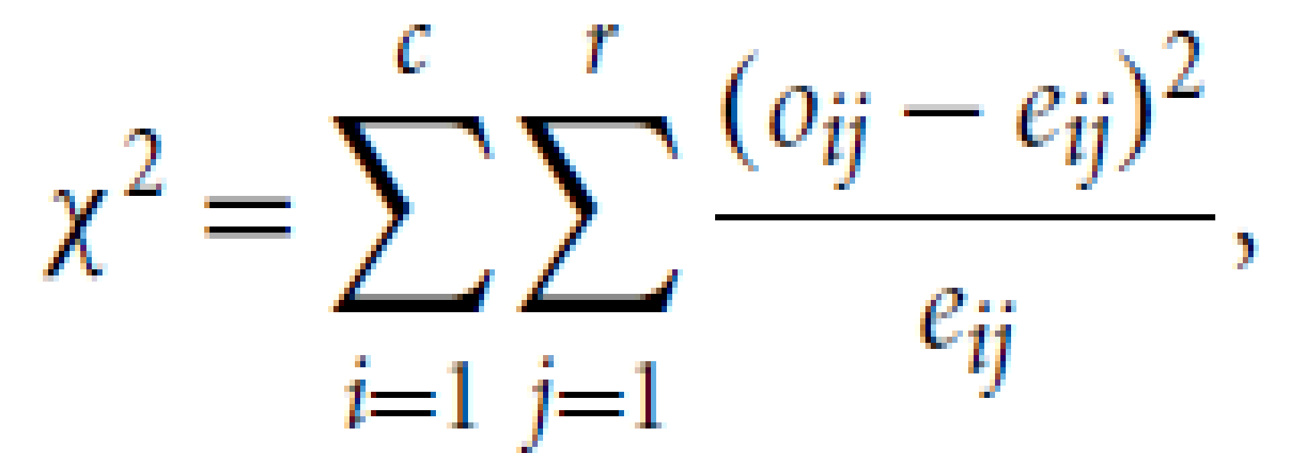
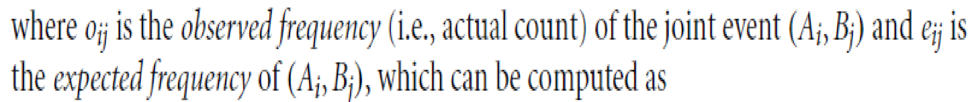
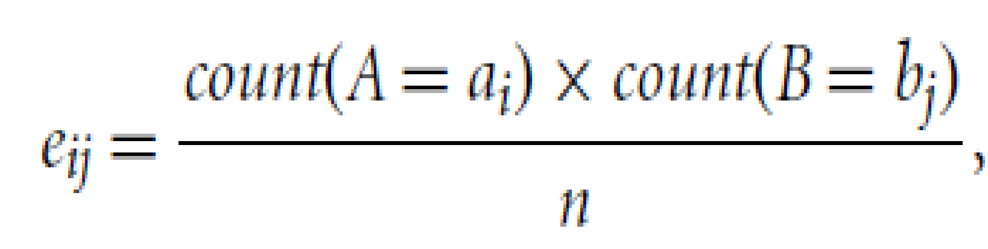
x² Correlation Test for Nominal Data
Suppose attribute A has c distinct values, namely a₁,a₂, ….a_{c} .
Attribute B has r distinct values, namely b₁,b₂, ….b_{r} .
Let (A_{i} ,Bj_{j}) denote the joint event that attribute A takes on value a_{i} and attribute B takes on value b_{j}
The x² value (also known as the Pearson x² statistic) is computed as:
‹#›

Slide 27
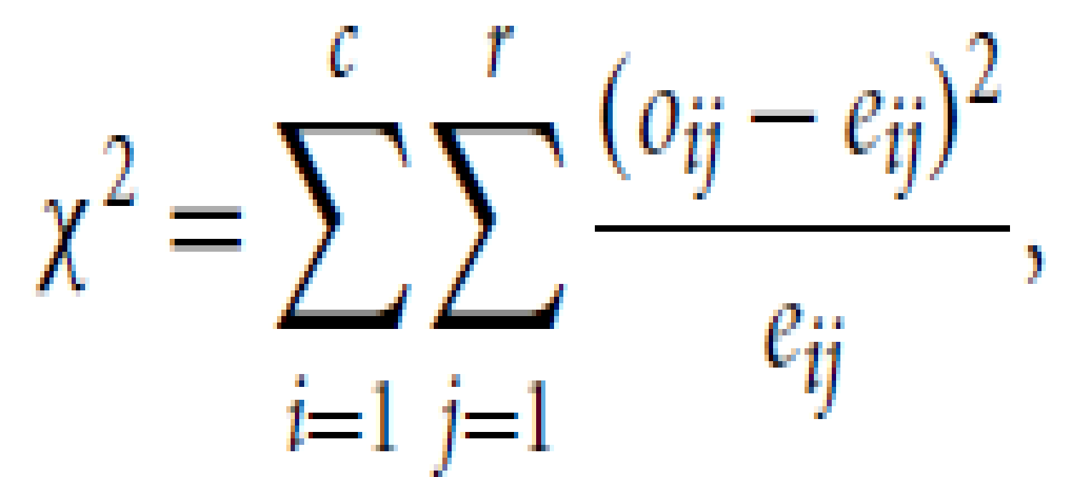
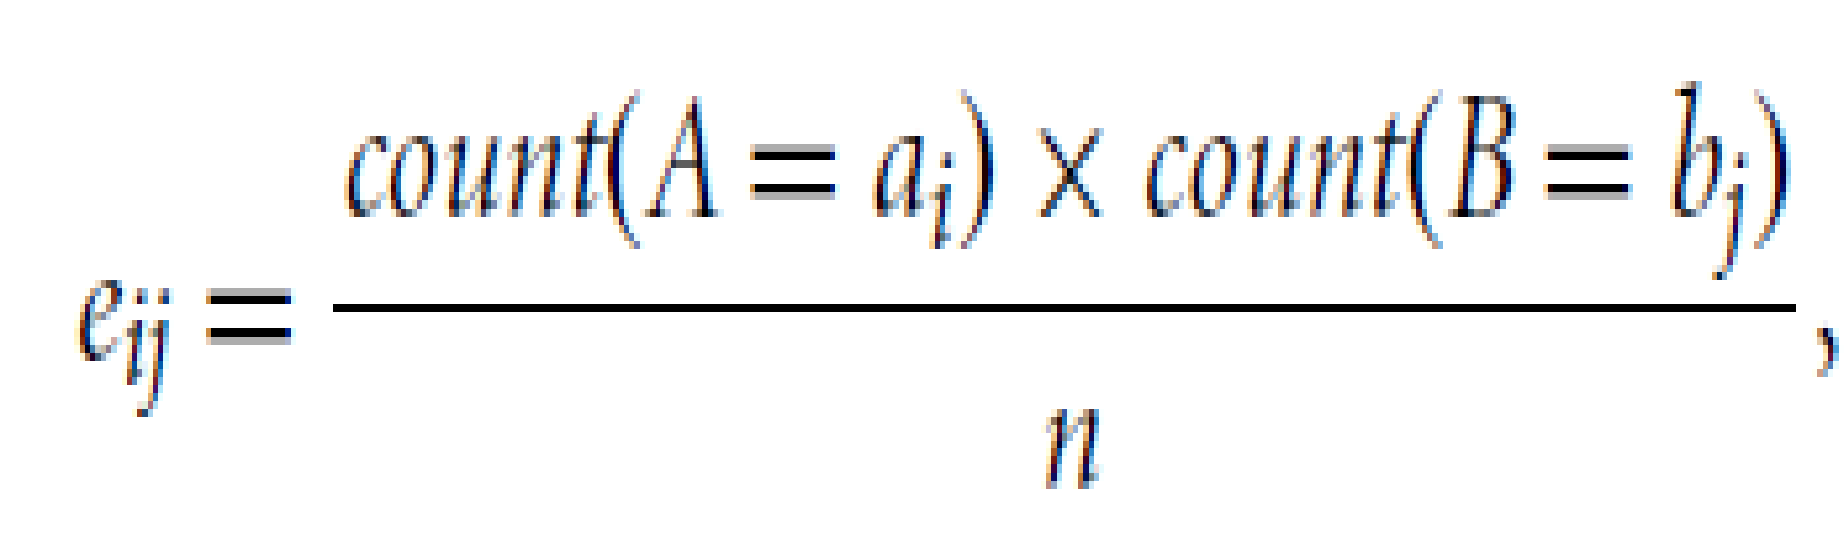
x² Correlation Test for Nominal Data
The x² statistic tests the hypothesis that A and B are independent, that is, there is no correlation between them.
The test is based on a significance level, with (r-1)x(c-1) degrees of freedom.
If the sample statistic x² > tabulated statistics x² _{α,dof} , the null hypothesis that A and B are independent is rejected, So, we say that A and B are statistically correlated.
DOF: No of values in the final calculation of the statistic that are free to vary.
Level of significance: Prob of rejecting the null hypothesis when it is true.
‹#›

Slide 28
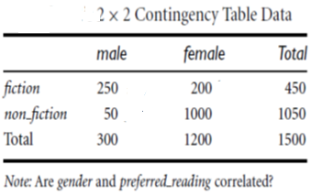
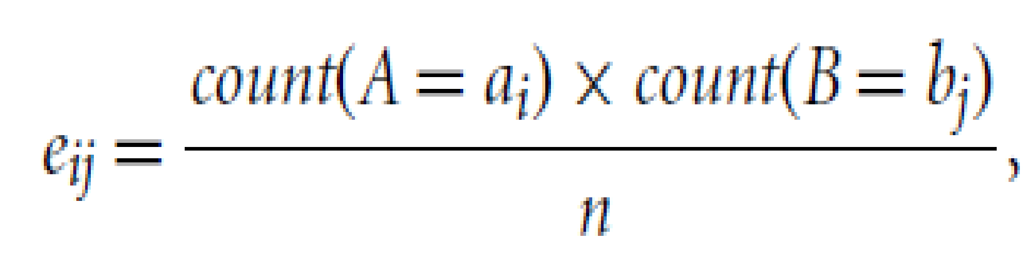
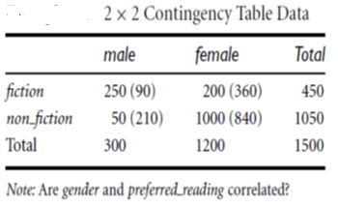
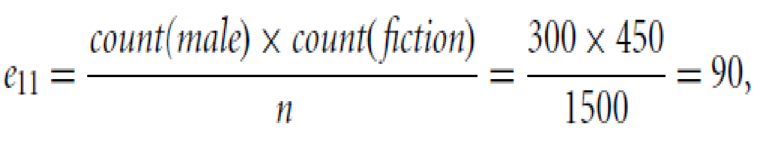
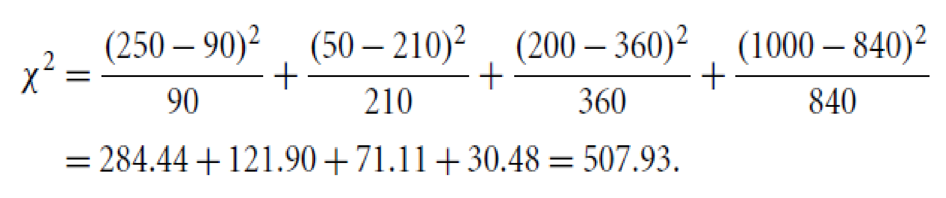
Example1: Correlation Analysis of Nominal attributes using x²
For this 2x2 table, the degrees of freedom are (2-1)(2-1)= 1.
For 1 degree of freedom , the x² value needed to reject the hypothesis at the 0.001 significance level is 10.828 (From Chi square distribution table)
Since our computed value is greater than tabulated value, we can reject the hypothesis that gender and preferred reading are independent and conclude that the two attributes are (strongly) correlated for the given group of people.
‹#›

Slide 29
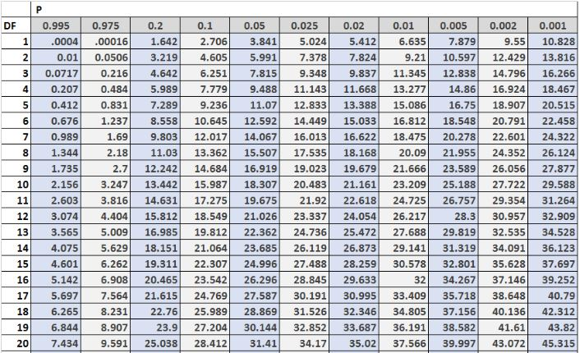
Chi-Square distribution table
‹#›

Slide 30
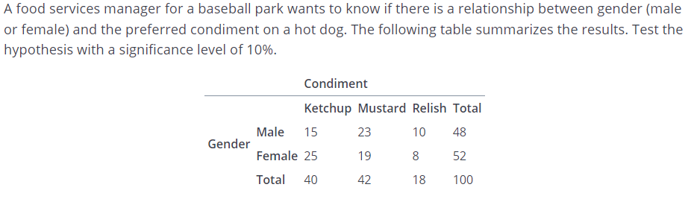
Example 2
Step 1: The hypotheses are:
H0: Gender and condiments are independent
H1 : Gender and condiments are not independent

Slide 31
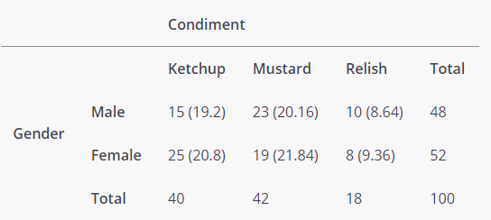
Example 2
Step 2: Find expected frequencies table

Slide 32
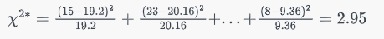
Example 2
Step 3: Calculate Chi square statistic
Step 4: DoF: (c-1)(r-1) =3 x 1 =3

Slide 33
Example 2
Step 3: Calculate Chi square statistic
Step 4: DoF: (c-1)(r-1) =3 x 1 =3
Step 5: Compare calculated test statistic with tabulated one.
Her Tabulated statistic(with significance level =0.01) = 11.345 > 2.95 .
Hence H0 is accepted. i.e attributes are independent.

Slide 34
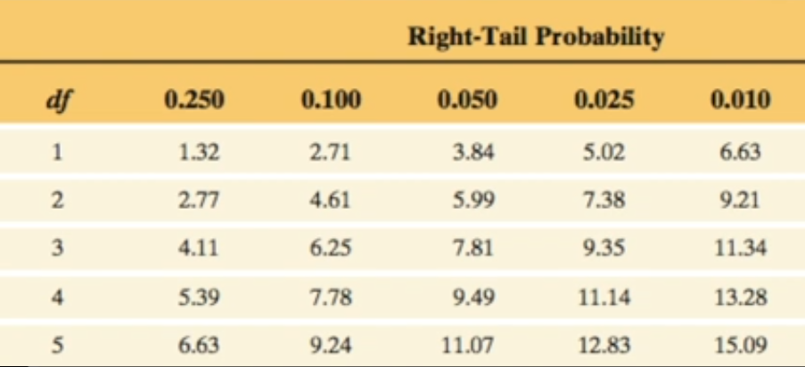
Correlation Analysis - Hypotheses
H₀ : Null Hypothesis - attributes are not related (ie Independent)
H₁ : Alternate Hypothesis - attributes are related (ie dependent)
Degree of freedom = (#rows-1 *#columns -1)
Given df and chi :
Find the p-value in Chi squared
distribution table depending on the prob
and chi value
The p-value *100 gives the % of likelihood
Given the df and p-value
Get the chi value from the table
Reject the null hypothesis if the value of chi is higher than the chi value obtained form tale
Else accept the null hypothesis if the obtained value of chi square is less than the tabular value.
‹#›

Slide 35
Chi-Square Calculation: Example 1
H₀: Science fiction is not associated with playing chess, and
H₁: Science fiction is associated with playing chess
df = (2-1)*(2-1) = 1
Χ² (chi-square) calculation (numbers in parenthesis are expected counts calculated based on the data distribution in the two categories)
P-value comes out to be 0 i.e there is 0 % likelihood of null hypothesis to be true.
It shows that like_science_fiction and play_chess are correlated in the group
 | Play chess | Not play chess | Sum (row)
Like science fiction | 250(90) | 200(360) | 450
Not like science fiction | 50(210) | 1000(840) | 1050
Sum(col.) | 300 | 1200 | 1500
‹#›

Slide 36
Chi-Square Calculation: Example 3
A group of students were classified in terms of personality (introvert or extrovert) and in terms of color preference (red, yellow, green or blue) with the purpose of seeing whether there is an association (relationship) between personality and color preference. Data was collected from 400 students and presented in the 2 (rows) x 4 (cols) contingency table below:
(Observed counts) | Colors
 | Red | Yellow | Green | Blue | Totals
Introvert personality | 20 | 6 | 30 | 44 | 100
Extrovert personality | 180 | 34 | 50 | 36 | 300
Totals | 200 | 40 | 80 | 80 | 400
Suitable null and alternative hypotheses might be:
H₀: Color preference is not associated with personality, and
H₁: Color preference is associated with personality
To perform a chi-squared test, the number of students expected in each cell of the table if the null hypothesis is true, is calculated.
X2 = 71.20
‹#›

Slide 37
Chi-Square Calculation: Example2
A group of students were classified in terms of personality (introvert or extrovert) and in terms of color preference (red, yellow, green or blue) with the purpose of seeing whether there is an association (relationship) between personality and color preference. Data was collected from 400 students and presented in the 2 (rows) x 4 (cols) contingency table below. Check whether color and personality attributes are correlated.
(Observed counts) | Colors
 | Red | Yellow | Green | Blue | Totals
Introvert personality | 20 | 6 | 30 | 44 | 100
Extrovert personality | 180 | 34 | 50 | 36 | 300
Totals | 200 | 40 | 80 | 80 | 400
X2 = 71.20
‹#›

Slide 38
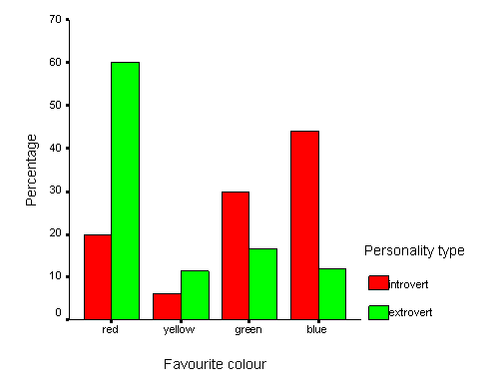
Chi-Square Calculation: Example 2
‹#›

Slide 39
Chi-Square Calculation: Example 3
Children of three ages are asked to indicate their preference for three photographs of adults. Do the data suggest that there is a significant relationship between age and photograph preference?
Age of child |  | photograph
 |  | A | B | C
 | 5-6 years | 18 | 22 | 20
 | 7-8 years | 2 | 28 | 40
 | 9-10 years | 20 | 10 | 40
‹#›

Slide 40
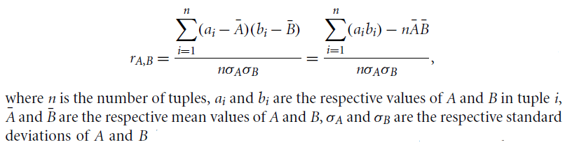

Correlation Analysis (Numerical Data)
For numeric attributes, we can evaluate the correlation between two attributes, A and B,by computing the correlation coefficient (also known as Pearson’s product moment coefficient
If r_{A,B} > 0, A and B are positively correlated (A’s values increase as B’s). The higher the value, the stronger correlation. Hence, a higher value may indicate that A (or B) may be removed as a redundancy.
r_{A,B} = 0: independent(no correlation);
r_{A,B} < 0: negatively correlated (A’s values increase as B’s decrease). This means that each attribute discourages the other
‹#›

Slide 41
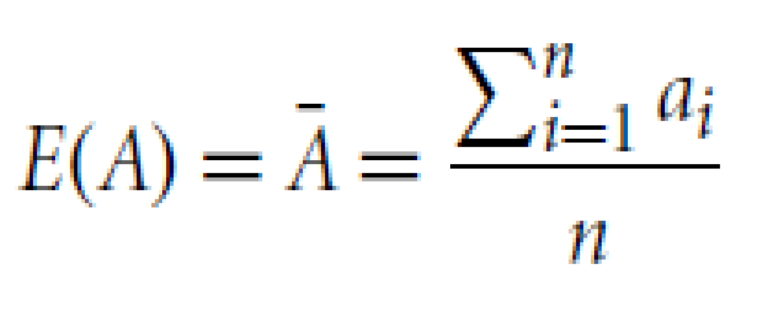
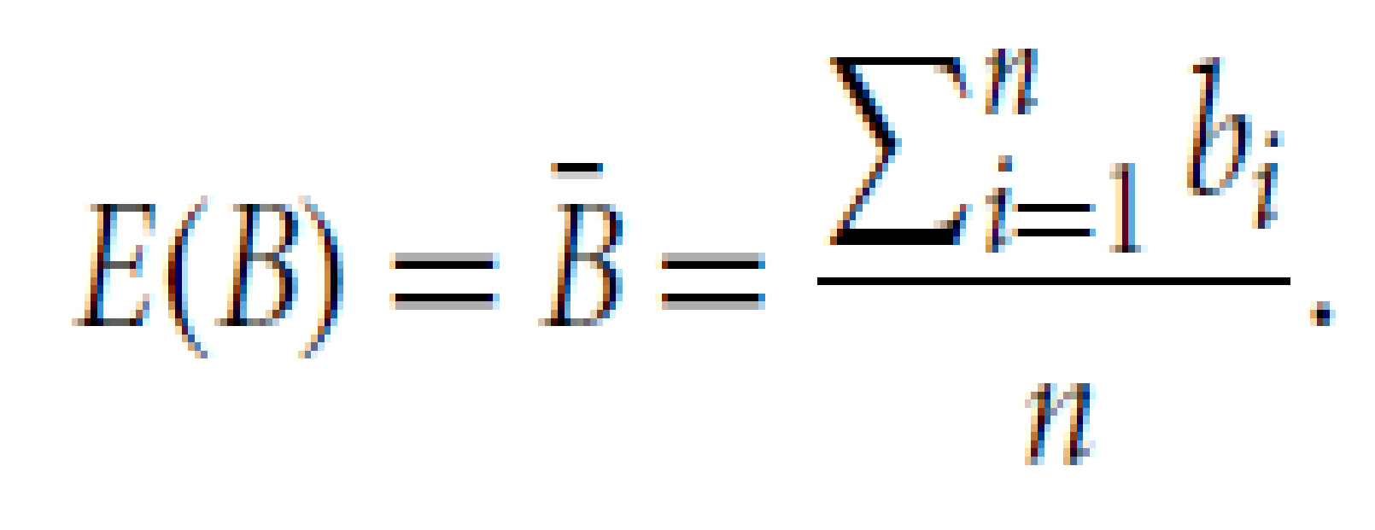
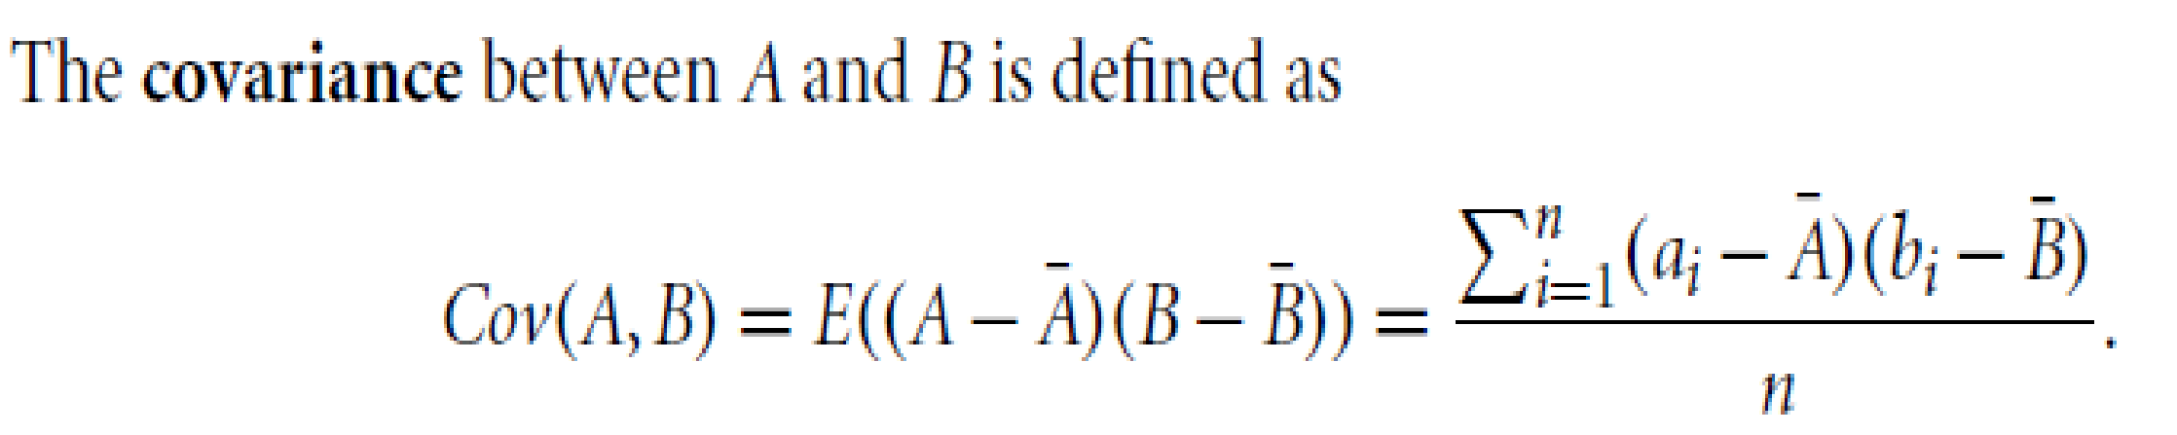

Covariance for Numerical Data
In probability theory and statistics, correlation and covariance are two similar measures for assessing how much two attributes change together.
Consider two numeric attributes A and B, and a set of n observations {(a1,b1),(a2,b2)…, (an,bn)}
The mean values of A and B, respectively, are also known as the expected values on A and B, that is, and
Also it can be shown that
‹#›

Slide 42
Covariance for Numerical Data
For two attributes A and B that tend to change together, if A is larger than (the expected value of A), then B is likely to be larger than (the expected value of B).
Therefore, the covariance between A and B is positive.
On the other hand, if one of the attributes tends to be above its expected value when the other attribute is below its expected value, then the covariance of A and B is negative.
If A and B are independent (i.e., they do not have correlation), then E(A.B)= E(A).E(B) Therefore, the covariance is
However, the converse is not true. Some pairs of random variables (attributes) may have a covariance of 0 but are not independent
‹#›

Slide 43
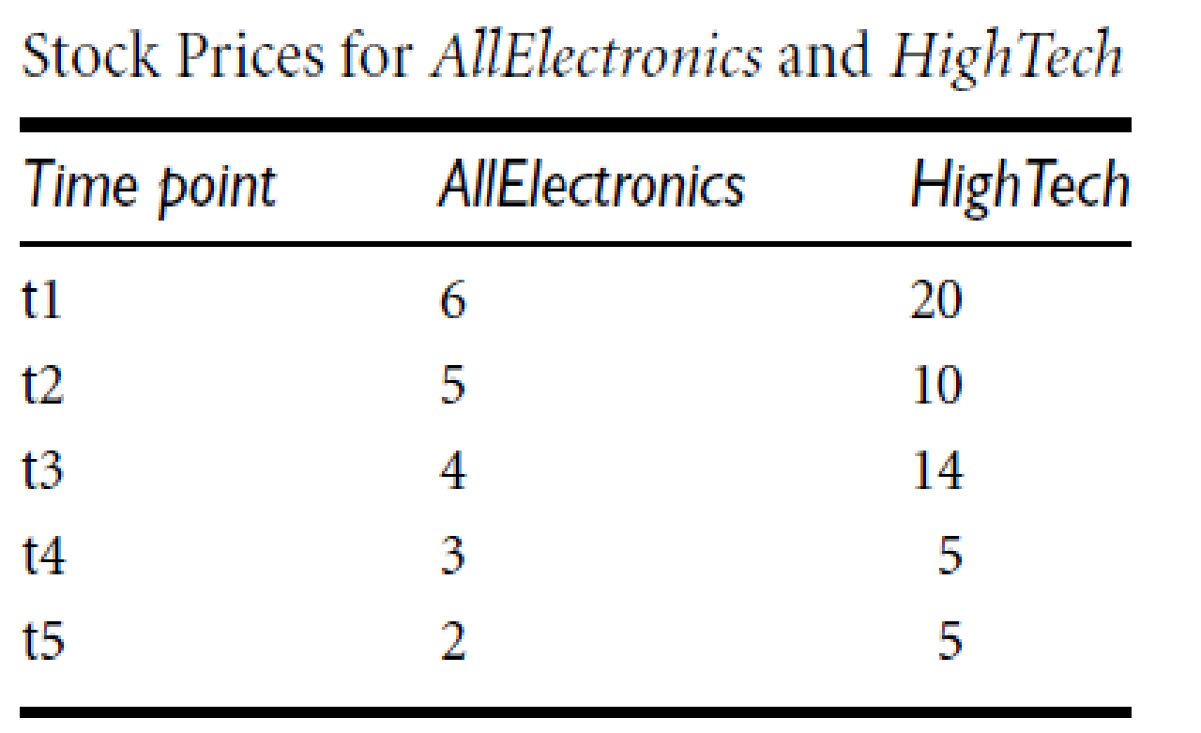
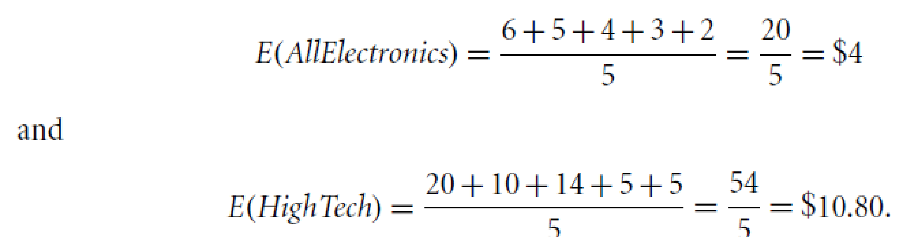
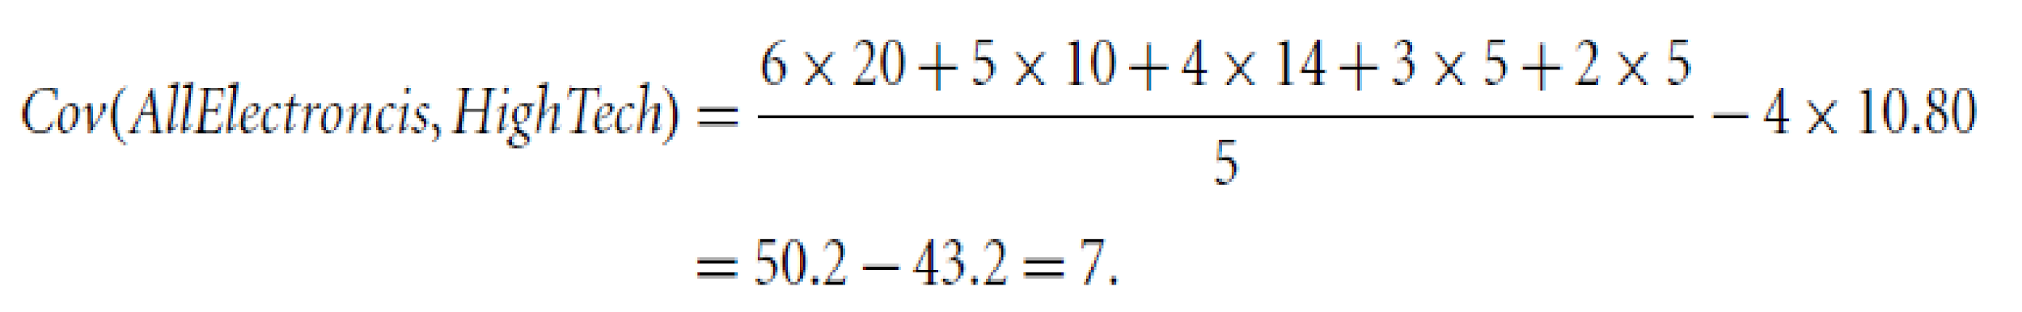
Example: Covariance for Numerical Data
I if the stocks are affected by the same industry
trends will their prices rise or fall together?
Therefore, given the positive covariance we can say that stock prices for both companies rise together.
‹#›

Slide 44
Tuple Duplication
In addition to detecting redundancies between attributes, duplication should also be detected at the tuple level (e.g., where there are two or more identical tuples for a given unique data entry case).
‹#›

Slide 45
Data Value conflict detection and Resolution
For the same real-world entity, attribute values from different sources may differ.
This may be due to differences in representation, scaling, or encoding.
Attributes may also differ on the abstraction level, where an attribute in one system is recorded at, say, a lower abstraction level than the “same” attribute in another.
‹#›

Slide 46
Data Preprocessing
Why preprocess the data?
Data cleaning
Data integration and transformation
Data reduction
Discretization and concept hierarchy generation
Summary
‹#›

Slide 47
Data Reduction Strategies
https://www.javatpoint.com/data-reduction-in-data-mining
‹#›

Slide 48
Data Reduction Strategies
Obtain a reduced representation of the data set that is much smaller in volume but yet produce the same (or almost the same) analytical results
Sometimes, it is also performed to find the most suitable subset of attributes from a large number of attributes. This is known as dimensionality reduction.
Data reduction also involves reducing the number of attribute values and/or the number of tuples.
‹#›

Slide 49
Data Reduction Techniques
Data cube aggregation: In this technique the data is reduced by applying OLAP operations like slice, dice or rollup. It uses the smallest level necessary to solve the problem.
Dimensionality reduction: The data attributes or dimensions are reduced. Not all attributes are required for data mining. The most suitable subset of attributes are selected by using techniques like forward selection, backward elimination, decision tree induction or a combination of forward selection and backward elimination.
Data compression: In this technique. large volumes of data is compressed i.e. the number of bits used to store data is reduced. This can be done by using lossy or lossless compression. In loss compression, the quality of data is compromised for more compression. In lossless compression, the quality of data is not compromised for higher compression level.
Numerosity reduction : This technique reduces the volume of data by choosing smaller forms for data representation. Numerosity reduction can be done using histograms, clustering or sampling of data. Numerosity reduction is necessary as processing the entire data set is expensive and time consuming.

Slide 50
Data Reduction Techniques
Dimensionality reduction:
It eliminates outdated or redundant features.
3 methods are :
Wavelet Transform:The discrete wavelet transform (DWT) is a linear signal processing technique that, when applied to a data vector X, transforms it to a numerically different vector, X’ of wavelet coefficients.
The compressed data is obtained by retaining the smallest fragment of the strongest wavelet coefficients. Wavelet transform can be applied to data cubes, sparse data, or skewed data.
Principal Component Analysis: Suppose we have a data set to be analyzed that has tuples with n attributes. The principal component analysis identifies k independent tuples with n attributes that can represent the data set. In this way, the original data can be cast on a much smaller space, and dimensionality reduction can be achieved. Principal component analysis can be applied to sparse and skewed data.
Attribute Subset Selection:

Slide 51
Data Reduction Techniques
Dimensionality reduction:
Attribute Subset Selection: The attribute subset selection reduces the volume of data by eliminating redundant and irrelevant attributes.
The most suitable subset of attributes are selected by using techniques like forward selection, backward elimination, decision tree induction or a combination of forward selection and backward elimination.
The attribute subset selection ensures that we get a good subset of original attributes even after eliminating the unwanted attributes. The resulting probability of data distribution is as close as possible to the original data distribution using all the attributes.

Slide 52
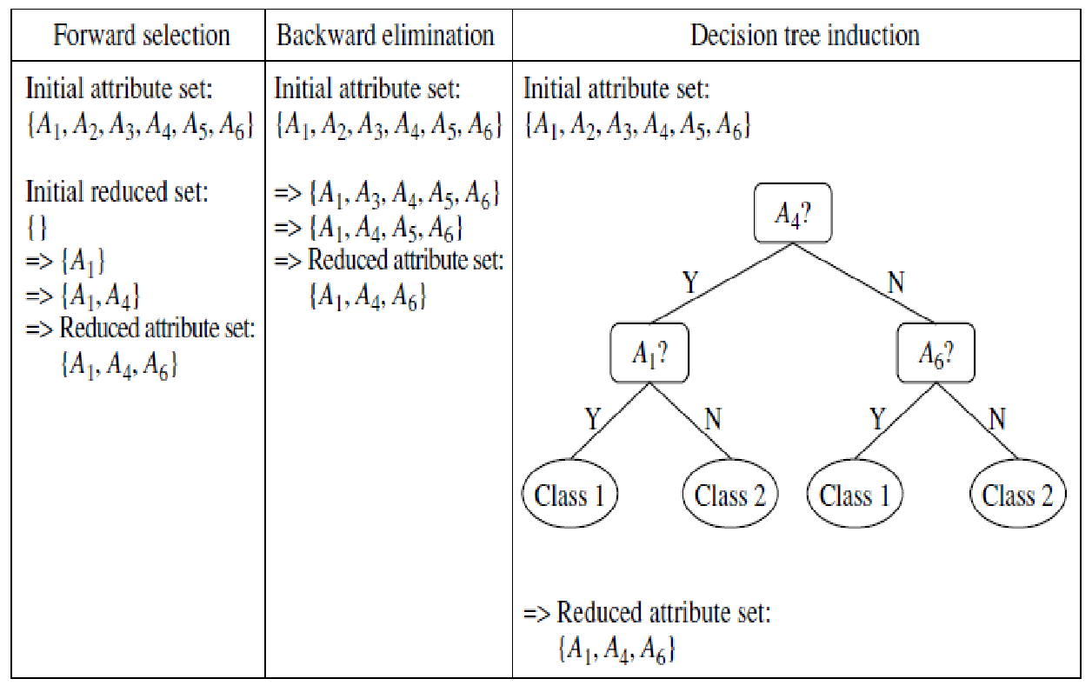
Greedy(heuristic) methods for attribute subset selection
‹#›

Slide 53
1. Stepwise forward selection: The procedure starts with an empty set of attributes as
the reduced set. The best of the original attributes is determined and added to the
reduced set. At each subsequent iteration or step, the best of the remaining original
attributes is added to the set.
2. Stepwise backward elimination: The procedure starts with the full set of attributes.
At each step, it removes the worst attribute remaining in the set.
3. Combination of forward selection and backward elimination: The stepwise forward
selection and backward elimination methods can be combined so that, at each
step, the procedure selects the best attribute and removes the worst from among the
remaining attributes.
4. Decision tree induction: Decision tree algorithms (e.g., ID3, C4.5, and CART) were
originally intended for classification. Decision tree induction constructs a flowchart like
structure where each internal (nonleaf) node denotes a test on an attribute, each
branch corresponds to an outcome of the test, and each external (leaf) node denotes a
class prediction. At each node, the algorithm chooses the “best” attribute to partition
the data into individual classes.
When decision tree induction is used for attribute subset selection, a tree is constructed
from the given data. All attributes that do not appear in the tree are assumed
to be irrelevant. The set of attributes appearing in the tree form the reduced subset
of attributes.
The stopping criteria for the methods may vary. The procedure may employ a threshold
on the measure used to determine when to stop the attribute selection process.

Slide 54
Data Reduction Strategies
Why data reduction?
A database/data warehouse may store terabytes of data
Complex data analysis/mining may take a very long time to run on the complete data set
Data reduction
Obtain a reduced representation of the data set that is much smaller in volume but yet produce the same (or almost the same) analytical results
Data reduction strategies
Dimensionality reduction — e.g., remove unimportant attributes
Wavelet Transform, PCA, Attribute subset selection
Numerosity reduction — e.g., fit data into models
Parametric methods: Regression, log-linear models
Non parametric methods: histograms, clustering, sampling and data cube aggregation
Data Compression
‹#›

Slide 55
Dimensionality Reduction: Wavelet Transformation
The discrete wavelet transform (DWT) is a linear signal processing technique that, when applied to a data vector X, transforms it to a numerically different vector, X’ of wavelet coefficients.
Compressed approximation: store only a small fraction of the strongest of the wavelet coefficients.
Similar to discrete Fourier transform (DFT), but better lossy compression.
Popular wavelet transforms include the Haar-2, Daubechies-4,and Daubechies-6.
Haar2
Daubechie4
‹#›

Slide 56
Dimensionality Reduction: Wavelet Transformation
Haar2
Daubechie4
Method:
1. The length, L, of the input data vector must be an integer power of 2. This condition
can be met by padding the data vector with zeros as necessary (L >= n).
2. Each transform involves applying two functions. The first applies some data smoothing,
such as a sum or weighted average. The second performs a weighted difference,
which acts to bring out the detailed features of the data.
3. The two functions are applied to pairs of data points in X, that is, to all pairs of
measurements (x_{2i} ,x_{2i+1}). This results in two data sets of length L=2.
In general, these represent a smoothed or low-frequency version of the input data and the high frequency content of it, respectively.
4. The two functions are recursively applied to the data sets obtained in the previous
loop, until the resulting data sets obtained are of length 2.
5. Selected values from the data sets obtained in the previous iterations are designated the wavelet coefficients of the transformed data.
‹#›

Slide 57
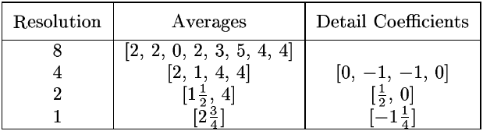
Wavelet Decomposition
Wavelets: A math tool for space-efficient hierarchical decomposition of functions
S = [2, 2, 0, 2, 3, 5, 4, 4] can be transformed to S^ = [2³/₄, -1¹/₄, ¹/₂, 0, 0, -1, -1, 0]
Compression: many small detail coefficients can be replaced by 0’s, and only the significant coefficients are retained
‹#›
Notes:
‹#›

Slide 58
Haar Wavelet Coefficients
Coefficient “Supports”
₊
Hierarchical decomposition structure (a.k.a. “error tree”)
2.75
₋
2.75
₊
+
-1.25
₋
+
-1.25
-
₊
0.5
₋
0.5
0
₊
+
-
+
-
0
₋
0
-1
-1
0
₊
0
₋
+
-
+
-
+
-
+
-
₊
₋
-1
2 2 0 2 3 5 4 4
₊
-1
₋
₊
Original frequency distribution
0
‹#›
Notes:
‹#›

Slide 59
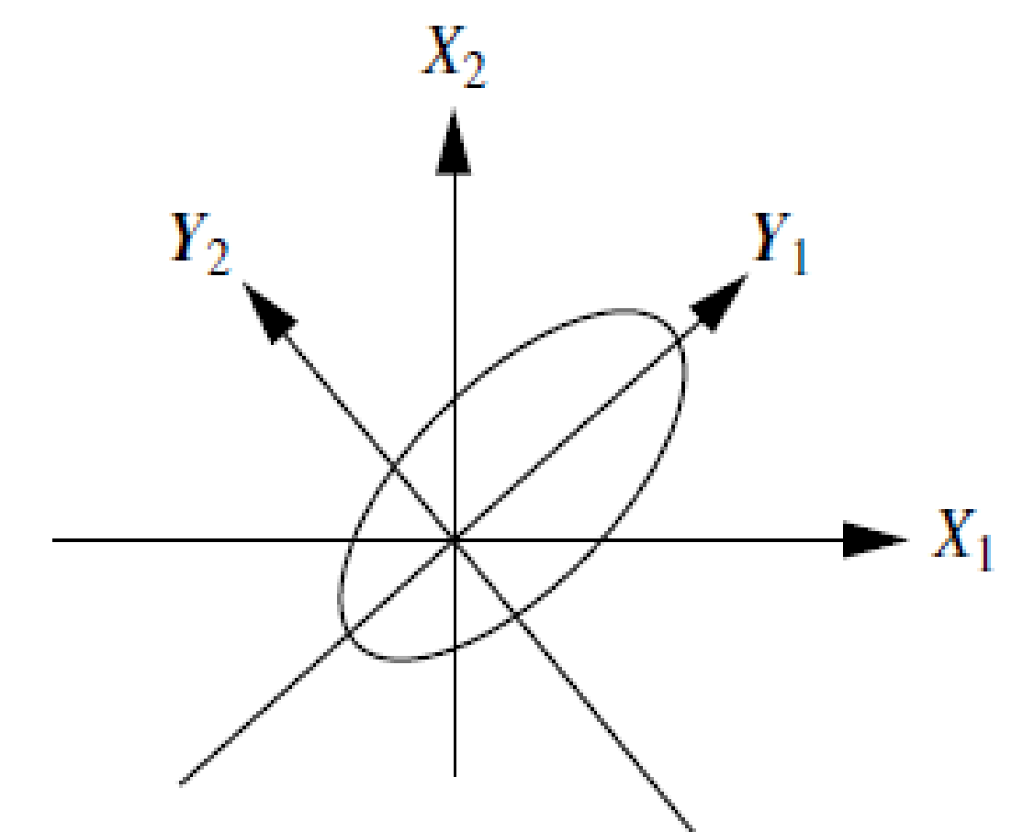
Dimensionality Reduction: Principal Component Analysis (PCA)
Given N data vectors from n-dimensions, find k ≤ n orthogonal vectors (principal components) that can be best used to represent data
Steps
Normalize input data: Each attribute falls within the same range
Compute k orthonormal (unit) vectors, i.e., principal components
Each input data (vector) is a linear combination of the k principal component vectors
The principal components are sorted in order of decreasing “significance” or strength
Since the components are sorted, the size of the data can be reduced by eliminating the weak components, i.e., those with low variance. (i.e., using the strongest principal components, it is possible to reconstruct a good approximation of the original data
Works for numeric data only
Used when the number of dimensions is large
‹#›

Slide 60
Dimensionality Reduction: Principal Component Analysis (PCA)-Example
Given the following data, use PCA to reduce dimensions from 2 to 1
Feature | Ex1 | Ex2 | Ex3 | Ex4
X | 4 | 8 | 13 | 7
Y | 11 | 4 | 5 | 14
Step1: For given dataset, n=No. of features=2
N: No. of samples =4
Step3.1: Find covariance of all ordered pairs (x,x),(x,y),(y,x) and (y,y)
Cov(x,x)=(1/(4-1)) *(4-8)(4-8)+(8-8)(8-8)+(13-8)(13-8)+(7-8)(7-8)=14
Cov(x,y)=(1/(4-1)) *(4-8)(11-8.5)+(8-8)(4-8.5)+(13-8)(5-8.5)+(7-8)(14-8.5)=-11
Cov(y,x)=Cov(x,y)= -11
Cov(y,y)=23
‹#›

Slide 61
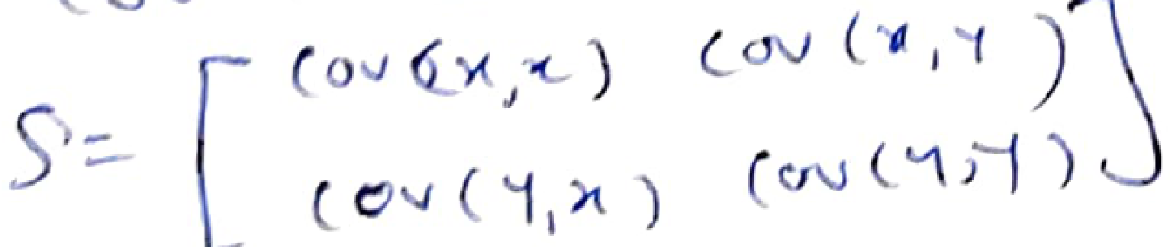
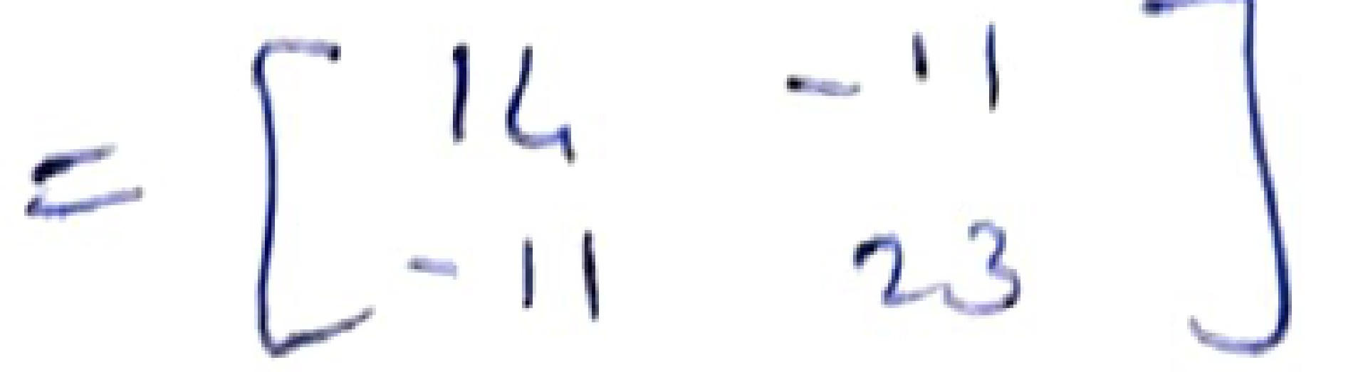
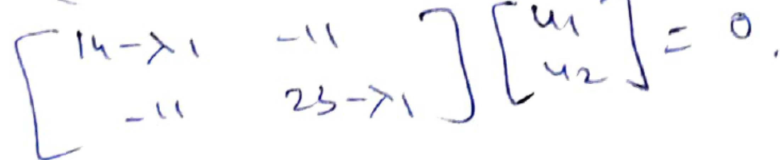
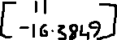
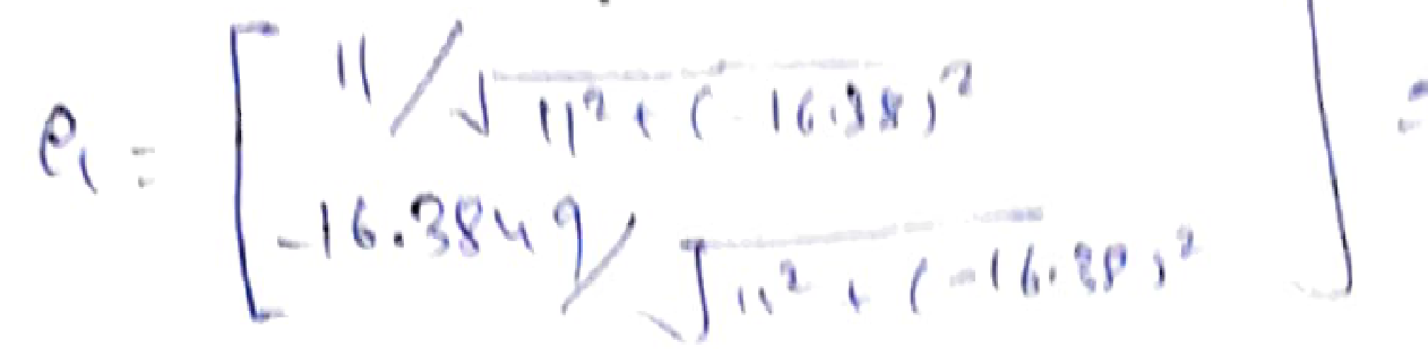
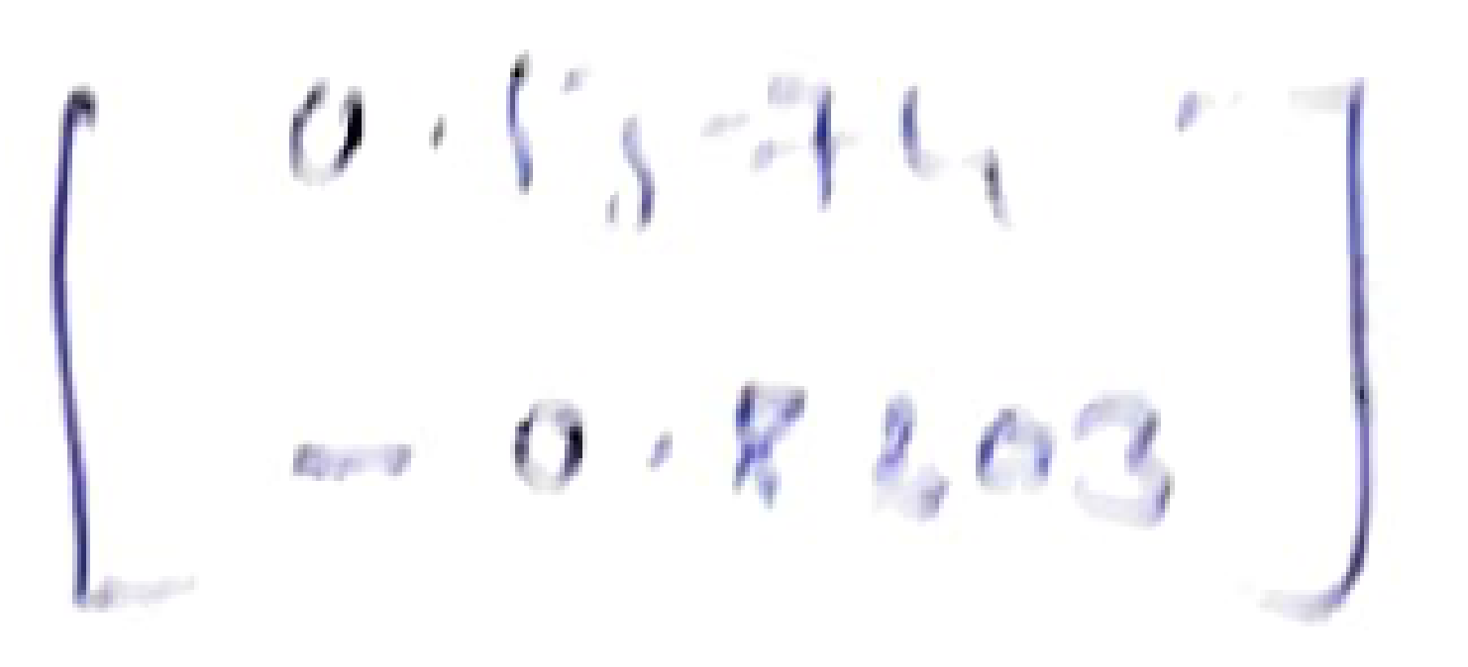
PCA Example (Cntd…)
Step 3.2 Find Covariance matrix n x n i.e 2 x 2
Step 4: : Find Eigen Value , Eigen Vector and Normalized Eigen Vector
1) Find Eigen Value λ : det(S-λI)=0
λ = 30.3849, 6.6151 . Hence λ₁= 30.3849 , λ₂=6.6151
[Longest Eigen value is first principal component]
2) Find Eigen Vector of λ₁ (U1) : (S-λ₁I)U₁=0
Solving, U1=
3) Normalize the eigen vector U1
‹#›

Slide 62
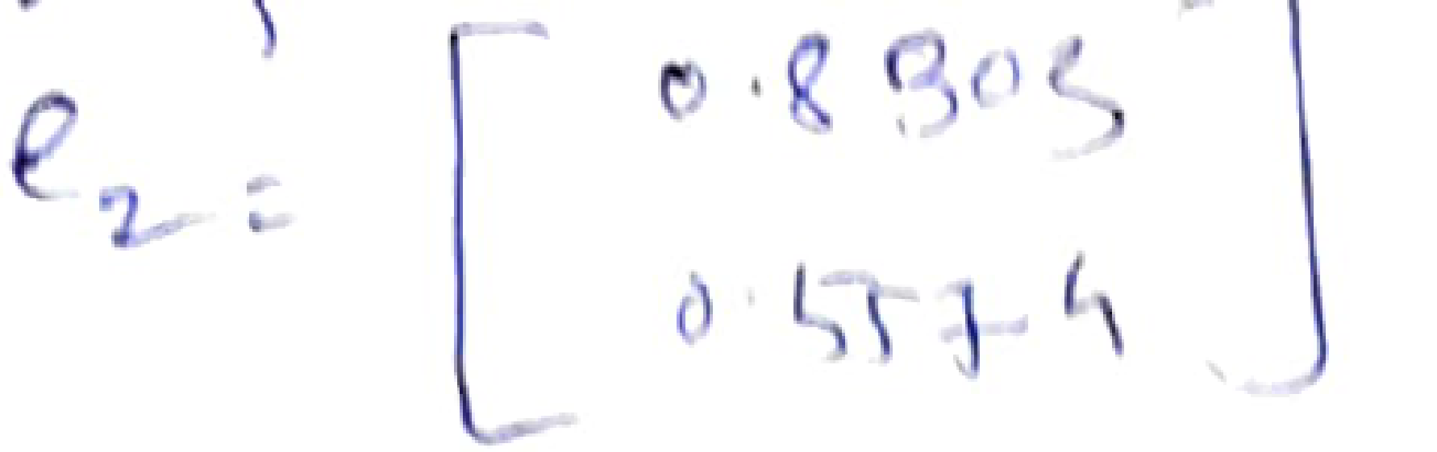
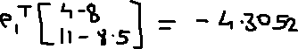
PCA Example (Cntd…)
Similarly find Eigen vector U2 and normalized eigen vector e2
Step 5: Derive new dataset
P11=
P12=3.7361
P13=5.6928
P14=-5.1238
Dataset with 1 feature is:
 | Ex1 | Ex2 | Ex3 | Ex4
First Principal Component PC1 | P11 | P12 | P13 | P14
 | Ex1 | Ex2 | Ex3 | Ex4
First Principal Component PC1 | -4.3052 | 3.7361 | 5.6928 | 5.1238
‹#›

Slide 63
Principal Component Analysis
X2
Y1
Y2
X1
‹#›

Slide 64
Attribute Subset Selection
Attribute subset selection reduces the data set size by removing irrelevant or redundant attributes (or dimensions).
The goal of attribute subset selection is to find a minimum set of attributes such that the resulting probability distribution of the data classes is as close as possible to the original distribution obtained using all attributes.
Mining on a reduced set of attributes has an additional benefit: It reduces the number of attributes appearing in the discovered patterns, helping to make the patterns easier to understand.
Basic heuristic methods of attribute subset selection include
Step-wise forward selection
Step-wise backward elimination
Combining forward selection and backward elimination
Decision-tree induction
‹#›

Slide 65
Greedy(heuristic) methods for attribute subset selection
‹#›

Slide 66
1. Stepwise forward selection: The procedure starts with an empty set of attributes as
the reduced set. The best of the original attributes is determined and added to the
reduced set. At each subsequent iteration or step, the best of the remaining original
attributes is added to the set.
2. Stepwise backward elimination: The procedure starts with the full set of attributes.
At each step, it removes the worst attribute remaining in the set.
3. Combination of forward selection and backward elimination: The stepwise forward
selection and backward elimination methods can be combined so that, at each
step, the procedure selects the best attribute and removes the worst from among the
remaining attributes.
4. Decision tree induction: Decision tree algorithms (e.g., ID3, C4.5, and CART) were
originally intended for classification. Decision tree induction constructs a flowchartlike
structure where each internal (nonleaf) node denotes a test on an attribute, each
branch corresponds to an outcome of the test, and each external (leaf) node denotes a
class prediction. At each node, the algorithm chooses the “best” attribute to partition
the data into individual classes.
When decision tree induction is used for attribute subset selection, a tree is constructed
fromthe given data. All attributes that do not appear in the tree are assumed
to be irrelevant. The set of attributes appearing in the tree form the reduced subset
of attributes.
The stopping criteria for the methods may vary. The procedure may employ a threshold
on the measure used to determine when to stop the attribute selection process.

Slide 67
Numerosity Reduction
Reduce data volume by choosing alternative, smaller forms of data representation
Parametric methods
Assume the data fits some model, estimate model parameters, store only the parameters, and discard the data (except possible outliers)
Example: Log-linear models—obtain value at a point in m-D space as the product on appropriate marginal subspaces
Non-parametric methods
Do not assume models
Major families: histograms, clustering, sampling
‹#›

Slide 68
Regression Analysis and Log-Linear Models: Parametric Data Reduction
Linear regression: Data are modeled to fit a straight line.
Y = w X + b
Two regression coefficients, w and b, specify the line and are to be estimated by using the data at hand
Using the least squares criterion to the known values of Y1, Y2, …, X1, X2, ….
Multiple regression: allows a response variable Y to be modeled as a linear function of multidimensional feature vector
Y = b0 + b1 X1 + b2 X2.
Many nonlinear functions can be transformed into the above
Log-linear models: approximates discrete multidimensional probability distributions
The multi-way table of joint probabilities is approximated by a product of lower-order tables
Notes:
‹#›

Slide 69
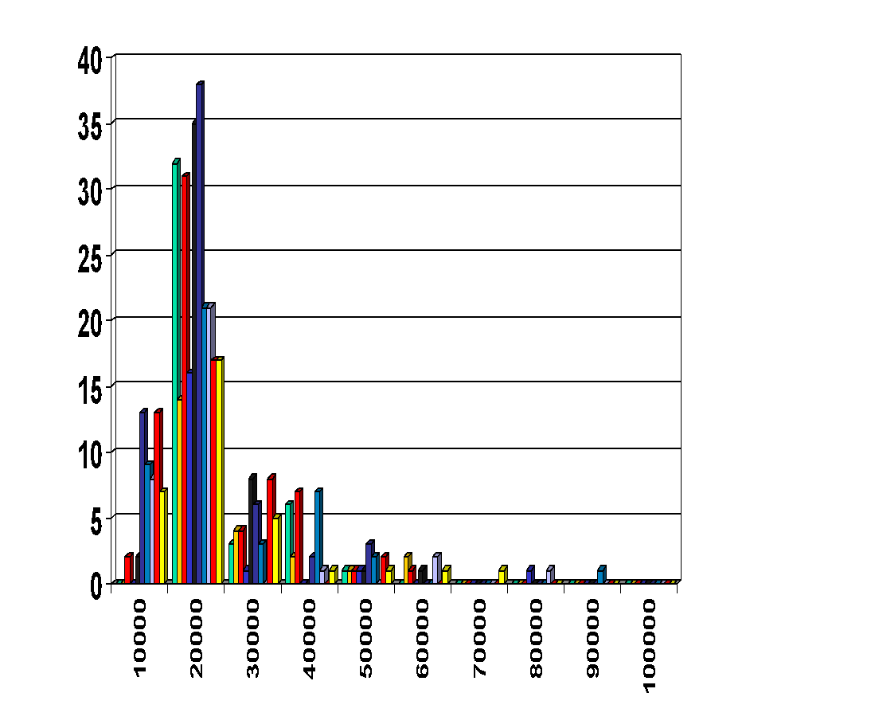
Non Parametric Data Reduction Method : Histograms
Divide data into buckets and store average (sum) for each bucket
Partitioning rules:
Equal-width: equal bucket range
Equal-frequency (or equal-depth)
‹#›

Slide 70
Non Parametric Data Reduction Method : Clustering
Partition data set into clusters based on similarity, and store cluster representation (e.g., centroid and diameter) only
Can be very effective if data is clustered but not if data is “smeared”
Can have hierarchical clustering and be stored in multi-dimensional index tree structures
There are many choices of clustering definitions and clustering algorithms
‹#›

Slide 71
Non Parametric Data Reduction Method : Sampling
Sampling: obtaining a small sample s to represent the whole data set N
Allow a mining algorithm to run in complexity that is potentially sub-linear to the size of the data
Choose a representative subset of the data
Simple random sampling may have very poor performance in the presence of skew
Develop adaptive sampling methods
Stratified sampling:
Approximate the percentage of each class (or subpopulation of interest) in the overall database
Used in conjunction with skewed data
Note: Sampling may not reduce database I/Os (page at a time)
‹#›

Slide 72
Non Parametric Data Reduction Method : Sampling
Sampling can be used as a data reduction technique because it allows a large data set to be represented by a much smaller random data sample (or subset).
Suppose that a large data set, D, contains N tuples.
Most common ways that we could sample D for data reduction includes:
Simple random sample without replacement (SRSWOR) of size s: This is created
by drawing s of the N tuples from D (s < N), where the probability of drawing any
tuple in D is 1/N, that is, all tuples are equally likely to be sampled.
Simple random sample with replacement (SRSWR) of size s: This is similar to
SRSWOR, except that each time a tuple is drawn from D, it is recorded and then
replaced. That is, after a tuple is drawn, it is placed back in D so that it may be drawn again.
‹#›

Slide 73
Sampling: with or without Replacement
SRSWOR
(simple random
sample without
replacement)
SRSWR
Raw Data
‹#›

Slide 74
Non Parametric Data Reduction Method : Sampling
Cluster sample: If the tuples in D are grouped into M mutually disjoint “clusters,”
then an SRS of s clusters can be obtained, where s < M. For example, tuples in a
database are usually retrieved a page at a time, so that each page can be considered
Stratified sample: If D is divided into mutually disjoint parts called strata, a stratified
sample of D is generated by obtaining an SRS at each stratum. This helps ensure a
representative sample, especially when the data are skewed.
Raw Data
Cluster/Stratified Sample
‹#›

Slide 75
Sampling: Cluster or Stratified Sampling
Raw Data
Cluster/Stratified Sample
‹#›

Slide 76
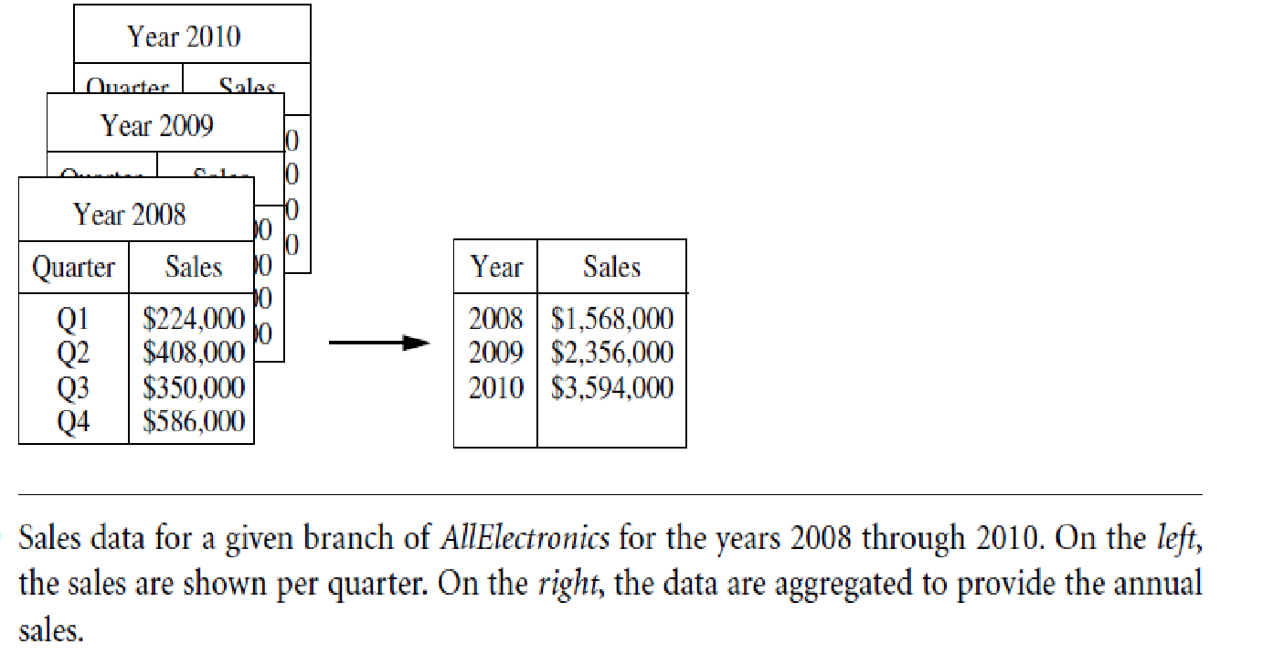
Data Cube Aggregation
‹#›

Slide 77
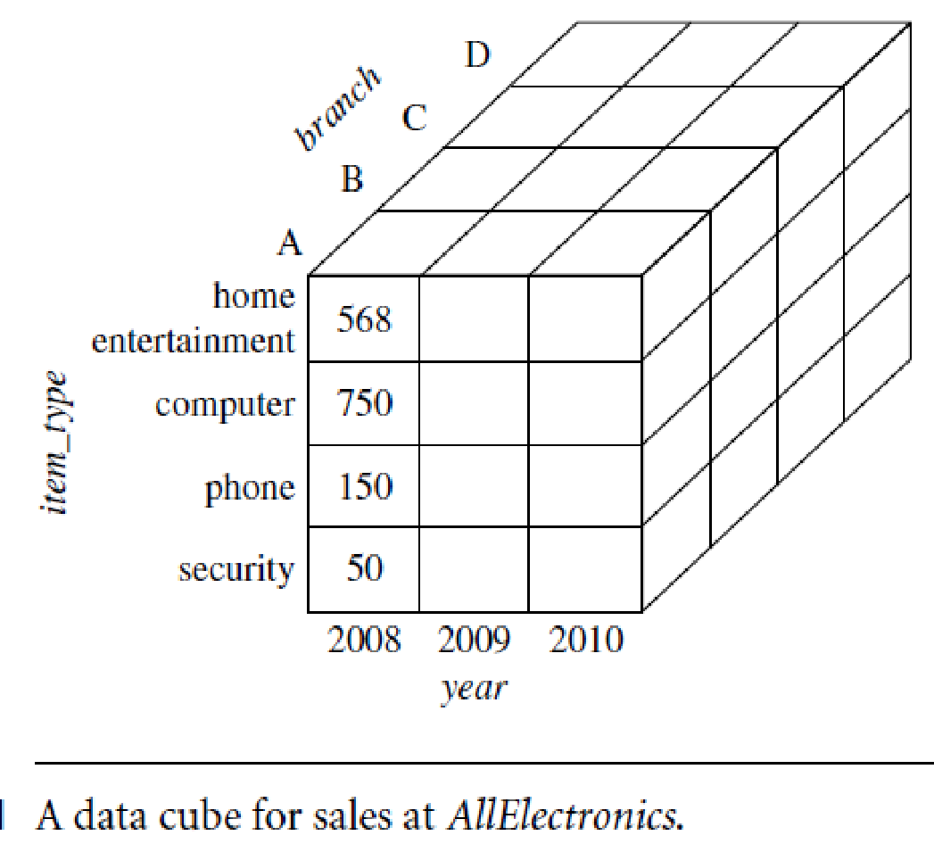
Data Cube Aggregation
The lowest level of a data cube (base cuboid)
The aggregated data for an individual entity of interest
E.g., a customer in a phone calling data warehouse
Highest level of a data cube (apex cuboid)
Multiple levels of aggregation in data cubes
Further reduce the size of data to deal with
Reference appropriate levels
Use the smallest representation which is enough to solve the task
Queries regarding aggregated information should be answered using data cube, when possible
‹#›

Slide 78
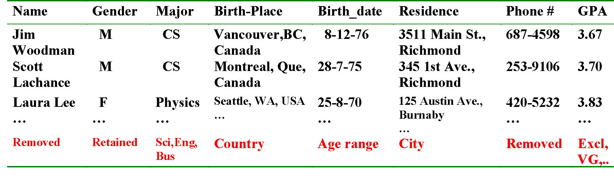
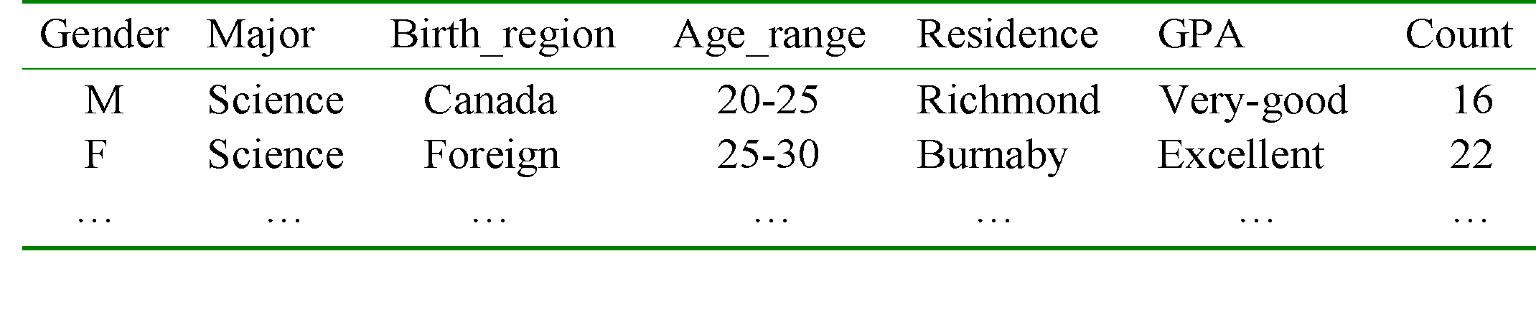
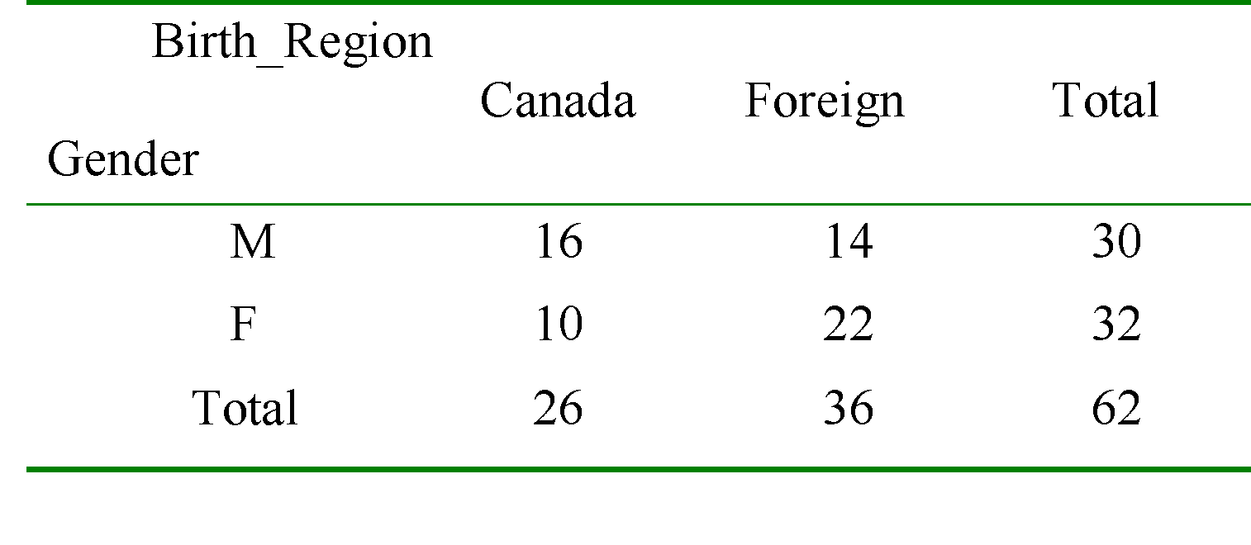
Class Characterization: An Example
Initial Relation
Prime Generalized Relation
‹#›
Notes:
‹#›

Slide 79
Basic Principles of Attribute-Oriented Induction
Data focusing: task-relevant data, including dimensions, and the result is the initial relation
Attribute-removal: remove attribute A if there is a large set of distinct values for A but (1) there is no generalization operator on A, or (2) A’s higher level concepts are expressed in terms of other attributes
Attribute-generalization: If there is a large set of distinct values for A, and there exists a set of generalization operators on A, then select an operator and generalize A
Attribute-threshold control: typical 2-8, specified/default
Generalized relation threshold control: control the final relation/rule size
‹#›
Notes:
‹#›

Slide 80
Attribute-Oriented Induction: Basic Algorithm
InitialRel: Query processing of task-relevant data, deriving the initial relation.
PreGen: Based on the analysis of the number of distinct values in each attribute, determine generalization plan for each attribute: removal? or how high to generalize?
PrimeGen: Based on the PreGen plan, perform generalization to the right level to derive a “prime generalized relation”, accumulating the counts.
Presentation: User interaction: (1) adjust levels by drilling, (2) pivoting, (3) mapping into rules, cross tabs, visualization presentations.
‹#›
Notes:
‹#›

Slide 81
Heuristic Feature Selection Methods
There are 2^{d} possible sub-features of d features
Several heuristic feature selection methods:
Best single features under the feature independence assumption: choose by significance tests
Best step-wise feature selection:
The best single-feature is picked first
Then next best feature condition to the first, ...
Step-wise feature elimination:
Repeatedly eliminate the worst feature
Best combined feature selection and elimination
Optimal branch and bound:
Use feature elimination and backtracking
‹#›

Slide 82
Data Compression
String compression
There are extensive theories and well-tuned algorithms
Typically lossless
But only limited manipulation is possible without expansion
Audio/video compression
Typically lossy compression, with progressive refinement
Sometimes small fragments of signal can be reconstructed without reconstructing the whole
Time sequence is not audio
Typically short and vary slowly with time
‹#›

Slide 83
Data Compression
Original Data
Compressed
Data
lossless
Original Data
Approximated
lossy
‹#›

Slide 84
Data Transformation
Data transformation is a technique used to convert the raw data into a suitable format that efficiently eases data mining and retrieves strategic information.
Data transformation includes data cleaning techniques and a data reduction technique to convert the data into the appropriate form.
Data transformation is an essential data preprocessing technique that must be performed on the data before data mining to provide patterns that are easier to understand.
Data transformation changes the format, structure, or values of the data and converts them into clean, usable data.
‹#›

Slide 85
Data Transformation Techniques
Data Smoothing
Data Aggregation
Data Generalization: concept hierarchy climbing
Data Normalization: scaled to fall within a small, specified range
min-max normalization
z-score normalization
normalization by decimal scaling
Attribute/feature construction
New attributes constructed from the given ones
Discretization
‹#›

Slide 86
Data Smoothing
Data smoothing is a process that is used to remove noise from the dataset using some algorithms.
It allows for highlighting important features present in the dataset. It helps in predicting the patterns.
When collecting data, it can be manipulated to eliminate or reduce any variance or any other noise form.
The concept behind data smoothing is that it will be able to identify simple changes to help predict different trends and patterns. This serves as a help to analysts or traders who need to look at a lot of data which can often be difficult to digest for finding patterns that they wouldn't see otherwise.
The noise is removed from the data using the techniques such as binning, regression, clustering.
Binning: This method splits the sorted data into the number of bins and smoothens the data values in each bin considering the neighborhood values around it.
Regression: This method identifies the relation among two dependent attributes so that if we have one attribute, it can be used to predict the other attribute.
Clustering: This method groups similar data values and form a cluster. The values that lie outside a cluster are known as outliers.

Slide 87
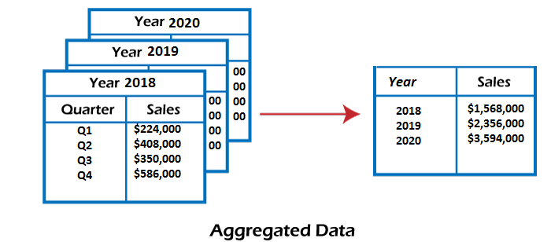
2. Data Aggregation
Data collection or aggregation is the method of storing and presenting data in a summary format.
This is a crucial step since the accuracy of data analysis insights is highly dependent on the quantity and quality of the data used.
Gathering accurate data of high quality and a large enough quantity is necessary to produce relevant results.
For example, we have a data set of sales reports of an enterprise that has quarterly sales of each year. We can aggregate the data to get the enterprise's annual sales report.

Slide 88
3. Data Generalization
It converts low-level data attributes to high-level data attributes using concept hierarchy. This conversion from a lower level to a higher conceptual level is useful to get a clearer picture of the data. Data generalization can be divided into two approaches:
Data cube process (OLAP) approach.
Attribute-oriented induction (AOI) approach.
For example, age data can be in the form of (20, 30) in a dataset. It is transformed into a higher conceptual level into a categorical value (young, old).

Slide 89
3. Data Generalization:concept hierarchy climbing
It converts low-level data attributes to high-level data attributes using concept hierarchy.
This conversion from a lower level to a higher conceptual level is useful to get a clearer picture of the data.
Data generalization can be divided into two approaches:
Data cube process (OLAP) approach.
Attribute-oriented induction (AOI) approach.
For example, age data can be in the form of (20, 30) in a dataset. It is transformed into a higher conceptual level into a categorical value (young, old).

Slide 90
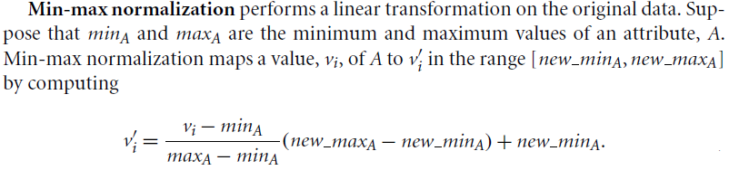
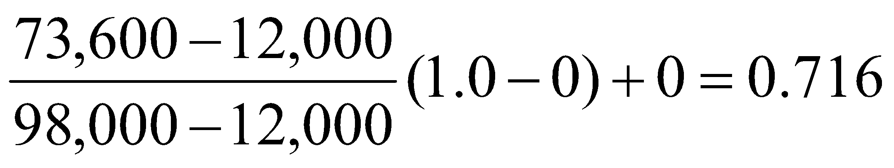

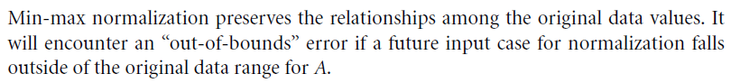
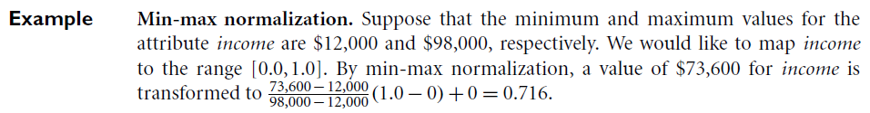
4. Normalization
(data scaled to fall within a small, specified range)
Min-max normalization:
Ex. Let income range $12,000 to $98,000 normalized to [0.0, 1.0]. Then $73,600 is mapped to
‹#›

Slide 91
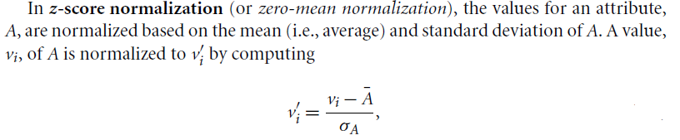
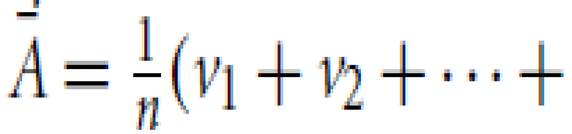
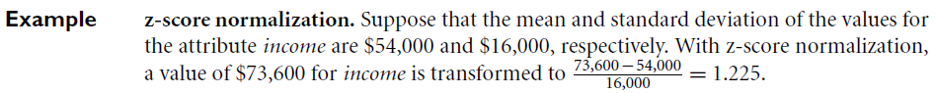
Data Transformation by Normalization
Z-score normalization
This method of normalization is useful when the actual minimum and maximum of attribute A are unknown, or when there are outliers that dominate the min-max normalization.
‹#›

Slide 92
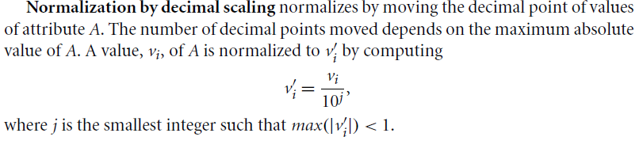

Data Transformation by Normalization
Decimal scaling normalization:
‹#›

Slide 93
5. Attribute Construction
In the attribute construction method, the new attributes consult the existing attributes to construct a new data set that eases data mining.
New attributes are created and applied to assist the mining process from the given attributes. This simplifies the original data and makes the mining more efficient.
For example, suppose we have a data set referring to measurements of different plots, i.e., we may have the height and width of each plot. So here, we can construct a new attribute 'area' from attributes 'height' and 'weight'.
Attribute construction also helps understand the relations among the attributes in a data set.
‹#›

Slide 94
6. Data Discretization
This is a process of converting continuous data into a set of data intervals. Continuous attribute values are substituted by small interval labels.
This makes the data easier to study and analyze.
If a data mining task handles a continuous attribute, then its discrete values can be replaced by constant quality attributes. This improves the efficiency of the task.
This method is also called a data reduction mechanism as it transforms a large dataset into a set of categorical data.
Discretization also uses decision tree-based algorithms to produce short, compact, and accurate results when using discrete values.
For example, the values for the age attribute can be replaced by the interval labels such as (0-10, 11-20…) or (kid, youth, adult, senior).
‹#›

Slide 95
Discretization
Three types of attributes:
Nominal — values from an unordered set, e.g., color, profession
Ordinal — values from an ordered set, e.g., military or academic rank
Continuous — real numbers, e.g., integer or real numbers
Discretization:
Divide the range of a continuous attribute into intervals
Some classification algorithms only accept categorical attributes.
Reduce data size by discretization
Prepare for further analysis
‹#›

Slide 96
Discretization by Binning
Binning is a top-down splitting technique based on a specified number of bins.
These methods are also used as discretization methods for data reduction and concept hierarchy generation.
For example, attribute values can be discretized by applying equal-width or equal-frequency binning, and then replacing each bin value by the bin mean or median, as in smoothing by bin means or smoothing by bin medians, respectively. These techniques can be applied recursively to the resulting partitions to generate concept hierarchies.
It is unsupervised discretization technique.
‹#›

Slide 97
Discretization by Histogram Analysis
Like binning, histogram analysis is an unsupervised discretization technique.
Various partitioning rules(equal width/equal size) can be used to define histograms.
The histogram analysis algorithm can be applied recursively to each partition in histogram in order to automatically generate a multilevel concept hierarchy, with the procedure terminating once a prespecified number of concept levels has been reached.
A minimum interval size can also be used per level to control the recursive procedure. This specifies the minimum width of a partition, or the minimum number of values for each partition at each level.
‹#›

Slide 98
Discretization by Clustering ,Decision Tree, Correlation Analysis
Discretization by Clustering
Clustering, decision tree analysis, and correlation analysis can be used for data discretization.
A clustering algorithm can be applied to discretize a numeric attribute, A, by partitioning the values of A into clusters or groups. Clustering takes the distribution of A into consideration, as well as the closeness of data points, and therefore is able to produce high-quality discretization results.
Clustering can be used to generate a concept hierarchy for A by following either a top-down splitting strategy or a bottom-up merging strategy, where each cluster forms a node of the concept hierarchy.
Discretization by Decision Tree:
Techniques to generate decision trees for classification can be applied to discretization.
These techniques employ a top-down splitting approach.
Decision tree approaches to discretization are supervised.
‹#›

Slide 99
Discretization by Decision Tree, Correlation Analysis
Discretization by Correlation Analysis:
Measures of correlation can be used for discretization.
ChiMerge is a x²-based discretization method which employs a bottom-up approach by finding the best neighboring intervals and then merging them to form larger intervals, recursively.
Supervised method
The basic notion is that for accurate discretization, the relative class frequencies should be fairly consistent within an interval. Therefore, if two adjacent intervals have a very similar distribution of classes, then the intervals can be merged. Otherwise, they should remain separate.
‹#›

